Slide 1

IRONHACK
“Tell me about yourself”: The Pitch
CAREERHACK

Slide 2


INDEX
What is a pitch and its purpose
The elements and structure
Examples
Best Practices

Slide 3
The pitch:
What it is and its purpose

Slide 4

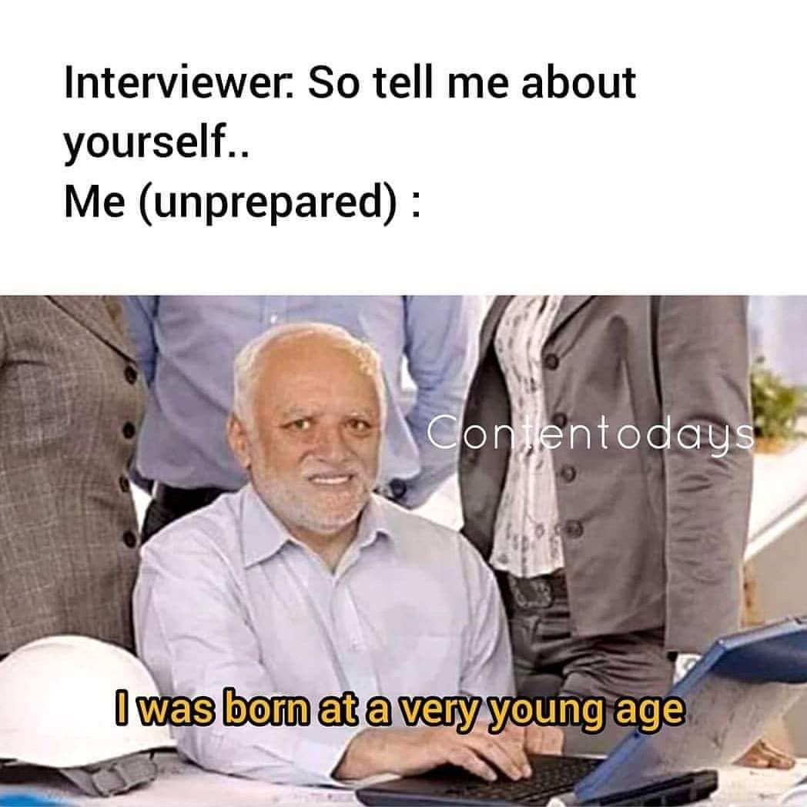
A pitch short summary of your skills, experience, and qualifications, as well as your goals and motivations for the role you are applying for.
Is the answer to the question: “Tell me about yourself”.
Notes:
Whats the enterprise model?
Ironhack attracts, qualifies, and trains Emerging Talent while reducing the risks by using a Hire, Train and Deploy model.
Ironhack manages the end-to-end process of creating a candidate pipeline, qualifying top performers, and building your team through intensive tech training.
Once trained, Ironhackers are deployed to your workforce through an accelerated 24-month program. Ironhack provides upskilling, mentorship, and community to reduce onboarding time, hand-holding from your team, and reduce attrition.
We employ Alumni, so you can focus on business as usual.
Once the assignment ends, Ironhackers become valuable team members. Convert to hire at no extra cost.
Since we continue to see those issues in all our hiring partners, we built a dedicated program that addresses them directly.."

Slide 5
What’s the pitch for?
Notes:
Whats the enterprise model?
Ironhack attracts, qualifies, and trains Emerging Talent while reducing the risks by using a Hire, Train and Deploy model.
Ironhack manages the end-to-end process of creating a candidate pipeline, qualifying top performers, and building your team through intensive tech training.
Once trained, Ironhackers are deployed to your workforce through an accelerated 24-month program. Ironhack provides upskilling, mentorship, and community to reduce onboarding time, hand-holding from your team, and reduce attrition.
We employ Alumni, so you can focus on business as usual.
Once the assignment ends, Ironhackers become valuable team members. Convert to hire at no extra cost.
Since we continue to see those issues in all our hiring partners, we built a dedicated program that addresses them directly.."

Slide 6
💯 To showcase the best of you.
What’s the pitch for?
Notes:
Whats the enterprise model?
Ironhack attracts, qualifies, and trains Emerging Talent while reducing the risks by using a Hire, Train and Deploy model.
Ironhack manages the end-to-end process of creating a candidate pipeline, qualifying top performers, and building your team through intensive tech training.
Once trained, Ironhackers are deployed to your workforce through an accelerated 24-month program. Ironhack provides upskilling, mentorship, and community to reduce onboarding time, hand-holding from your team, and reduce attrition.
We employ Alumni, so you can focus on business as usual.
Once the assignment ends, Ironhackers become valuable team members. Convert to hire at no extra cost.
Since we continue to see those issues in all our hiring partners, we built a dedicated program that addresses them directly.."

Slide 7
💯 To showcase the best of you.
🧑🏽‍💻 To introduce your personal and hard skills.
What’s the pitch for?
Notes:
Whats the enterprise model?
Ironhack attracts, qualifies, and trains Emerging Talent while reducing the risks by using a Hire, Train and Deploy model.
Ironhack manages the end-to-end process of creating a candidate pipeline, qualifying top performers, and building your team through intensive tech training.
Once trained, Ironhackers are deployed to your workforce through an accelerated 24-month program. Ironhack provides upskilling, mentorship, and community to reduce onboarding time, hand-holding from your team, and reduce attrition.
We employ Alumni, so you can focus on business as usual.
Once the assignment ends, Ironhackers become valuable team members. Convert to hire at no extra cost.
Since we continue to see those issues in all our hiring partners, we built a dedicated program that addresses them directly.."

Slide 8
💯 To showcase the best of you.
🧑🏽‍💻 To introduce your personal and hard skills.
What’s the pitch for?
🧠 Helps the recruiter remember you and understand your story.
Notes:
Whats the enterprise model?
Ironhack attracts, qualifies, and trains Emerging Talent while reducing the risks by using a Hire, Train and Deploy model.
Ironhack manages the end-to-end process of creating a candidate pipeline, qualifying top performers, and building your team through intensive tech training.
Once trained, Ironhackers are deployed to your workforce through an accelerated 24-month program. Ironhack provides upskilling, mentorship, and community to reduce onboarding time, hand-holding from your team, and reduce attrition.
We employ Alumni, so you can focus on business as usual.
Once the assignment ends, Ironhackers become valuable team members. Convert to hire at no extra cost.
Since we continue to see those issues in all our hiring partners, we built a dedicated program that addresses them directly.."

Slide 9
💯 To showcase the best of you.
🧑🏽‍💻 To introduce your personal and hard skills.
What’s the pitch for?
🧠 Helps the recruiter remember you and understand your story.
🦹🏽 Helps you to be prepared and more confident about your own story.
Notes:
Whats the enterprise model?
Ironhack attracts, qualifies, and trains Emerging Talent while reducing the risks by using a Hire, Train and Deploy model.
Ironhack manages the end-to-end process of creating a candidate pipeline, qualifying top performers, and building your team through intensive tech training.
Once trained, Ironhackers are deployed to your workforce through an accelerated 24-month program. Ironhack provides upskilling, mentorship, and community to reduce onboarding time, hand-holding from your team, and reduce attrition.
We employ Alumni, so you can focus on business as usual.
Once the assignment ends, Ironhackers become valuable team members. Convert to hire at no extra cost.
Since we continue to see those issues in all our hiring partners, we built a dedicated program that addresses them directly.."

Slide 10
Pitch elements
& Structure

Slide 11

Who are you?
I am a [Target role]
01

Slide 12
Who are you?
I am a [Target role]
01
02
What’s your experience?
With a background in…
X years of experience in…

Slide 13
What’s your unique value?
Who are you?
My experience with/working on XX environments, taught me [mention transferable skills].
I am a [Target role]
01
02
03
What’s your experience?
With a background in…
X years of experience in…

Slide 14
What’s your unique value?
Who are you?
My experience with/working on XX environments, taught me [mention transferable skills].
I am a [Target role]
01
02
03
04
What’s your experience?
Strong closure
With a background in…
X years of experience in…
I am confident that my knowledge in… and my ability to… will be of great value to this team/project.
Next goal (related to the opportunity).

Slide 15

Follow this basic structure
Introduction - who are you? (personal).
My name is ___, from _____, and I’m a junior [Full-stack developer]
SHORT background - what have you done so far? (professional).
Talk about WHY are you changing careers. Build the bridge between your background and your target role.
Your most recent/current experience - career changer (Ironhack) - FOCUS HERE.
You could mention:
A project you worked at Ironhack.
A past project related to the field.
Highlight transferable skills.
Next Goal. What are you looking for? (relate to the opportunity).

Slide 16
Let’s see an example

Slide 17
Let’s see an example
This is Jon 🧔🏽‍♂️

Slide 18
Let’s see an example
This is Jon 🧔🏽‍♂️
He just graduated from the Data Analytics bootcamp 👨🏽‍🎓

Slide 19
Let’s see an example
This is Jon 🧔🏽‍♂️
He just graduated from the Data Analytics bootcamp 👨🏽‍🎓
He used to work as a chef and as a waiter 👨🏽‍🍳

Slide 20
Let’s see an example
This is Jon 🧔🏽‍♂️
How could he possibly introduce himself without any related background? 👀
He just graduated from the Data Analytics bootcamp 👨🏽‍🎓
He used to work as a chef and as a waiter 👨🏽‍🍳

Slide 21
Let’s see an example
I am Jon, a data analyst recently graduated from Ironhack’s bootcamp. I come from The Netherlands, and I am excited to bring my analytical skills and problem-solving abilities to the field of data analysis.
My background in hospitality, both as a chef and waiter, has taught me the importance of attention to detail, organization, and the ability to work in fast-paced environments. These skills have prepared me to work effectively in a data-driven environment where accuracy and efficiency are critical.
Although I don't have direct experience as a data analyst, I believe that my background in hospitality has given me a unique perspective that can be applied to data analysis. As a chef, I learned to manage inventory, track costs, and optimize resources, which are all skills that are relevant to data analysis. As a waiter, I learned to prioritize tasks, manage time effectively, and communicate clearly, which are also important skills for a data analyst.
I am excited to apply my skills and experience to the field of data analysis and learn from experienced professionals. I am a quick learner, a team player, and I am dedicated to providing value to the company through my work. I am confident that my unique background and passion for data analysis make me a strong candidate for this position.
This is Jon 🧔🏽‍♂️
He just graduated from the Data Analytics bootcamp 👨🏽‍🎓
He used to work as a chef and as a waiter 👨🏽‍🍳

Slide 22
Another version of the pitch could be

Slide 23
Another version of the pitch could be
This is Isa 👩🏼‍🦰

Slide 24
Another version of the pitch could be
This is Isa 👩🏼‍🦰
She just graduated from the UX/UI design bootcamp 👩🏼‍🎓

Slide 25
Another version of the pitch could be
This is Isa 👩🏼‍🦰
She just graduated from the UX/UI design bootcamp 👩🏼‍🎓
She’s a psychologist used to work as a tech recruiter 👩🏼‍💻

Slide 26
Another version of the pitch could be
I'm Isa and besides UX Design, I'm passionate about playing the bass guitar in my band and practicing yoga almost every day. I guide myself by responsibility, honesty, commitment, perseverance, and freedom values.
I finished my Psychology degree seven years ago, and since then, I've worked as a tech recruiter in different internet companies. During this period, I've acquired interviewing skills, competitor analysis, and benchmarking skills. Of course, I've also learned how to communicate effectively and manage different stakeholders in complex situations.
During these years working as a tech recruiter, I fell in love with digital products, and that's why I decided to change my professional career.
Recently I finished the UXIUI Design Bootcamp at Ironhack. I've worked on six different projects to acquire a wide range of UX skills like Design Thinking, UX Research, UI Design, Information Architecture, and Usability testing. On my last project, I helped a vegan startup to improve their check-out journey for the restaurant experiences.
Now I'm looking to apply all that I've learned during this time in a company that wants to make people's lives better as I believe in empowering individuals with technology. That’s what brought me to XXX company.
This is Isa 👩🏼‍🦰
She just graduated from the UX/UI design bootcamp 👩🏼‍🎓
She’s a psychologist used to work as a tech recruiter 👩🏼‍💻

Slide 27
What makes a good pitch in the interview?

Slide 28
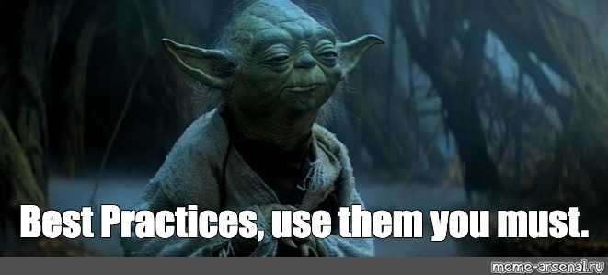

Slide 29
Keep it short and to the point. Between 1-2 minutes.

Slide 30
Keep it short and to the point. Between 1-2 minutes.
Keep it natural. Breathe, smile and be yourself. Own it.

Slide 31
Keep it short and to the point. Between 1-2 minutes.
Keep it natural. Breathe, smile and be yourself. Own it.
Practice. Practice gives you confidence. Nail it!

Slide 32
Keep it short and to the point. Between 1-2 minutes.
Keep it natural. Breathe, smile and be yourself. Own it.
Practice. Practice gives you confidence. Nail it!
Adapt it for different audiences and occasions. Tailor.

Slide 33
Keep it short and to the point. Between 1-2 minutes.
Keep it natural. Breathe, smile and be yourself. Own it.
Practice. Practice gives you confidence. Nail it!
Adapt it for different audiences and occasions. Tailor.
Tell a story. The more personal, authentic, relevant and relatable your pitch is the more you will stand out.

Slide 34
Keep it short and to the point. Between 1-2 minutes.
Keep it natural. Breathe, smile and be yourself. Own it.
Practice. Practice gives you confidence. Nail it!
Adapt it for different audiences and occasions. Tailor.
Tell a story. The more personal, authentic, relevant and relatable your pitch is the more you will stand out.
Deliver a key message. Know your goal & what you want to say.

Slide 35
The Challenge

Slide 36

Write a draft of your Pitch.
Dress up & practice the pitch in a video recording and get feedback from us or your colleagues.

Slide 37


